Slide 1
Different forms of ML workflows
Pravin Y Pawar
Extracted from
Three Levels of ML Software

Slide 2
Different forms of ML workflows
Operating an ML model might assume several architectural styles
Primarily Four architectural patterns which are classified along two dimensions:
ML Model Training
ML Model Prediction
For sake of simplicity disregard the third dimension - ML Model Type
which denotes the type of machine learning algorithm such as
Supervised
Unsupervised
Semi-supervised
and Reinforcement Learning

Slide 3
Model Training Patterns
Two ways to perform ML Model Training:
Offline learning
Online learning
Offline learning (aka batch or static learning)
The model is trained on a set of already collected data
After deploying to the production environment, the ML model remains constant until it re-trained
Model will see a lot of real-live data and becomes stale - ‘model decay’ and should be carefully monitored
Online learning (aka dynamic learning)
The model is regularly being re-trained as new data arrives, e.g. as data streams
Usually the case for ML systems that use time-series data, such as sensor, or stock trading data to accommodate the temporal effects in the ML model

Slide 4
Model Prediction Patterns
Two modes to denote the mechanics of the ML model to makes predictions
Batch predictions
Real-time predictions
Batch predictions
The deployed ML model makes a set of predictions based on historical input data
often sufficient for data that is not time-dependent, or when it is not critical to obtain real-time predictions as output
Real-time predictions (aka on-demand predictions)
Predictions are generated in real-time using the input data that is available at the time of the request

Slide 5
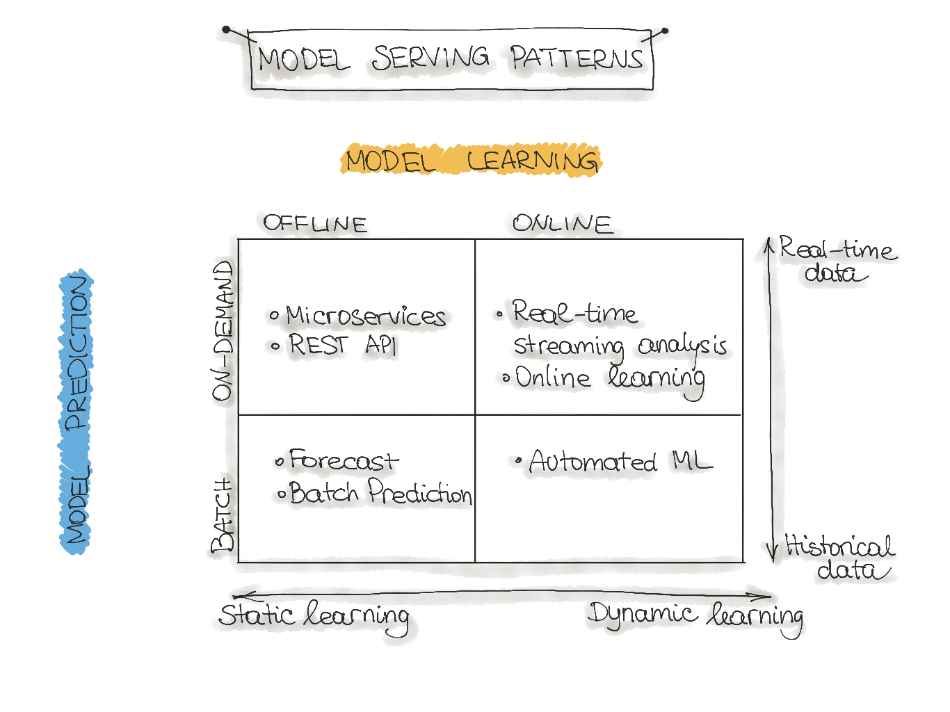
ML architecture patterns
Forecast, Web-Service, Online Learning, and AutoML

Slide 6
Forecast
Widely spread in academic research or data science education (e.g., Kaggle or DataCamp)
used to experiment with ML algorithms and data as it is the easiest way to create a machine learning system
not very useful in an industry setting for production systems (e.g. mobile applications)
Usually involves steps
take an available dataset
train the ML model
run this model on another (mostly historical) data
makes predictions

Slide 7
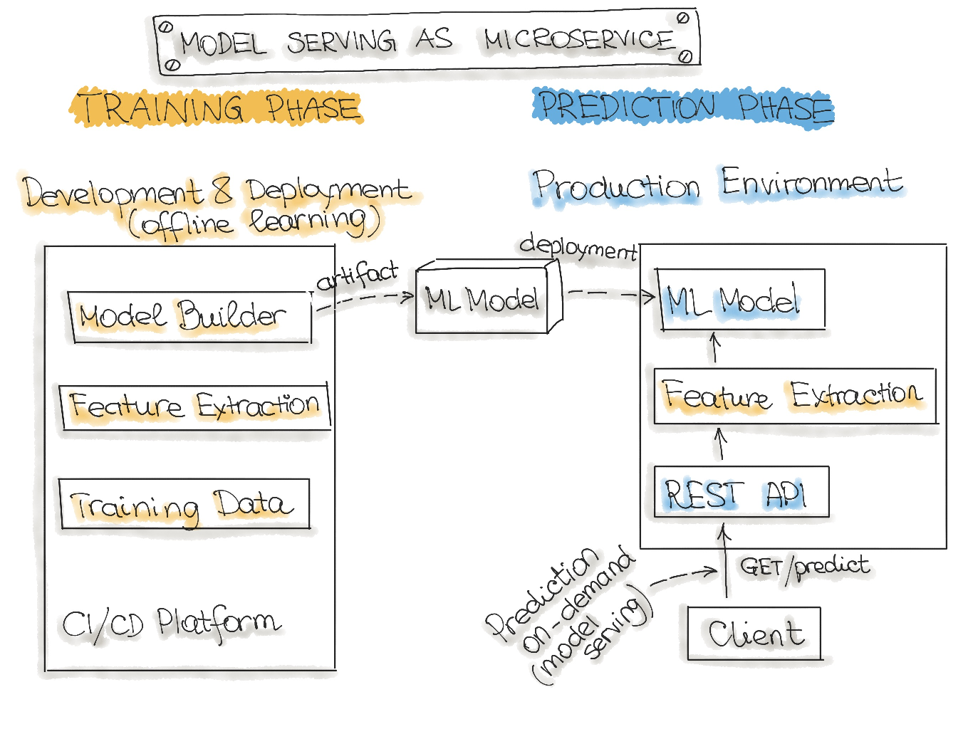
Web-Service (or Microservices)
Architecture for wrapping trained models as deployable services
The most commonly described deployment architecture for ML models
The web service takes input data and outputs a prediction for the input data points
Model is trained offline on historical data, but it uses real-live data to make predictions
Model remains constant until it is re-trained and re-deployed into the production system.
The difference from a forecast (batch predictions) is that
the ML model runs near real-time
handles a single record at a time instead of processing all the data at once

Slide 8
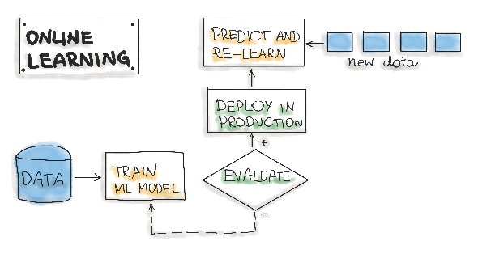
Online Learning (Real-time streaming analytics)
Most dynamic way to embed machine learning into a production system
Confusing name because the core learning or ML model
training is usually not performed on the live system
call it incremental learning- term online learning is already established within the ML community
In this type of ML workflow
ML learning algorithm is continuously receiving a data stream, either as single data points or in small groups called mini-batches
System learns about new data on the fly as it arrives, so the ML model is incrementally being re-trained with new data
Continually re-trained model is instantly available as a web service
Technically works well with the lambda architecture in big data systems
Model would typically run as a service on a Kubernetes cluster or similar
A big difficulty with the online learning system in production is that
if bad data is entering the system, the ML model, as well as the whole system performance, will increasingly decline

Slide 9
AutoML
Sophisticated version of online learning
AutoML is getting a lot of attention
considered the next advance for enterprise ML
promises training ML models with minimal effort and without machine learning expertise
User needs to provide data, and the AutoML system automatically selects an ML algorithm and configures the selected algorithm
very experimental way to implement ML workflows
usually provided by big cloud providers, such as Google or MS Azure
Instead of updating the model, need to execute an entire ML model training pipeline in production that results in new models on the fly

Slide 10
Thank You!
In our next session:

